Slide 1
Clusters Random Constant
ERP Plots of Averaged Electrodes per Cluster

Slide 2
Description of Presentation
Plotting each significant cluster of the contrast constant – random1 in a separate ERP-Plot Topoplot-Combination.
Time interval is from first significant cluster moment to the last
All Electrodes comprising the Clusters are averaged in the ERP plots
Going from smallest cluster to largest cluster each for positive and negative
For completeness, I added a similar visualization for occluded - visible

Slide 3
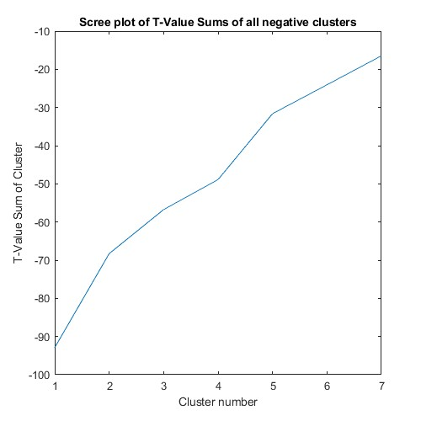
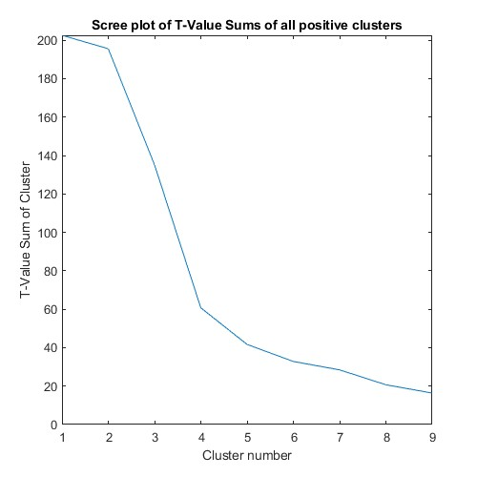
Scree Plots

Slide 4
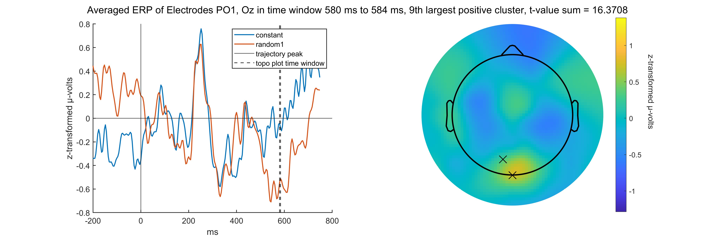
Topoplots Positive

Slide 5
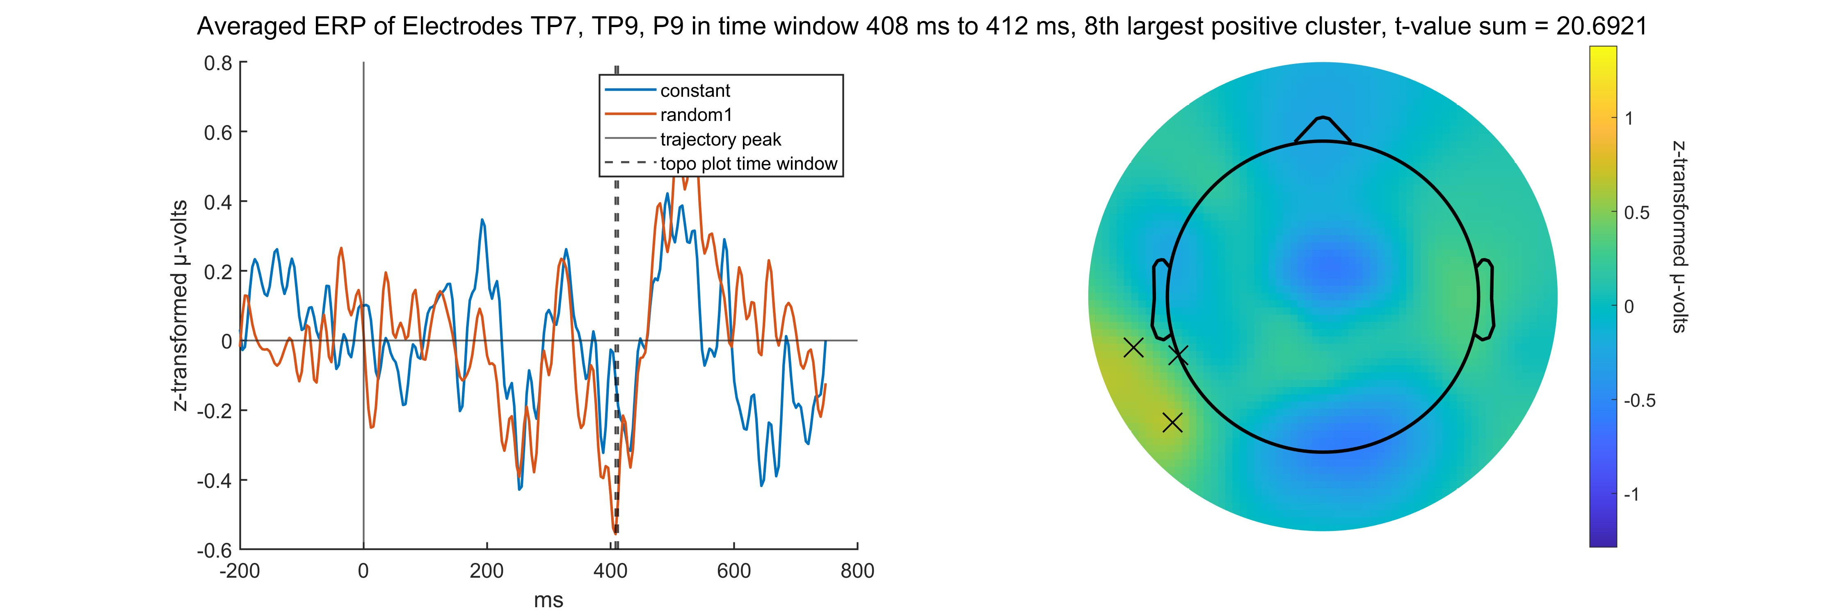
Topoplots Positive

Slide 6
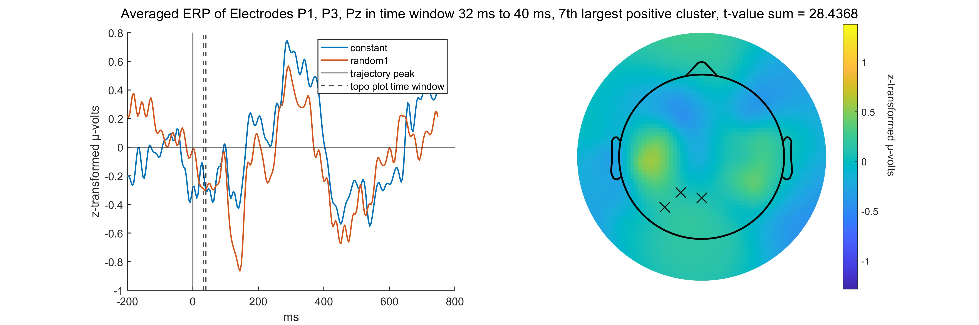
Topoplots Positive

Slide 7
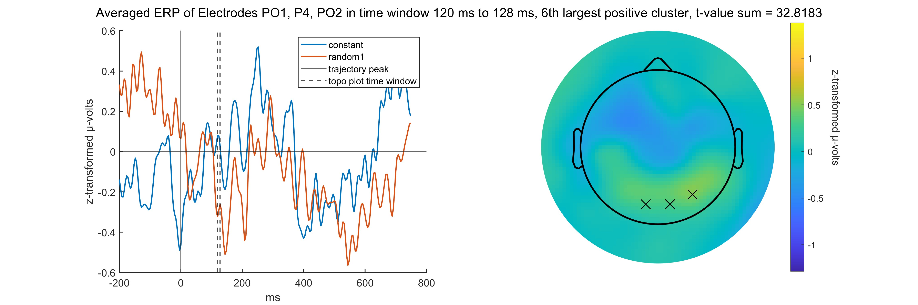
Topoplots Positive

Slide 8
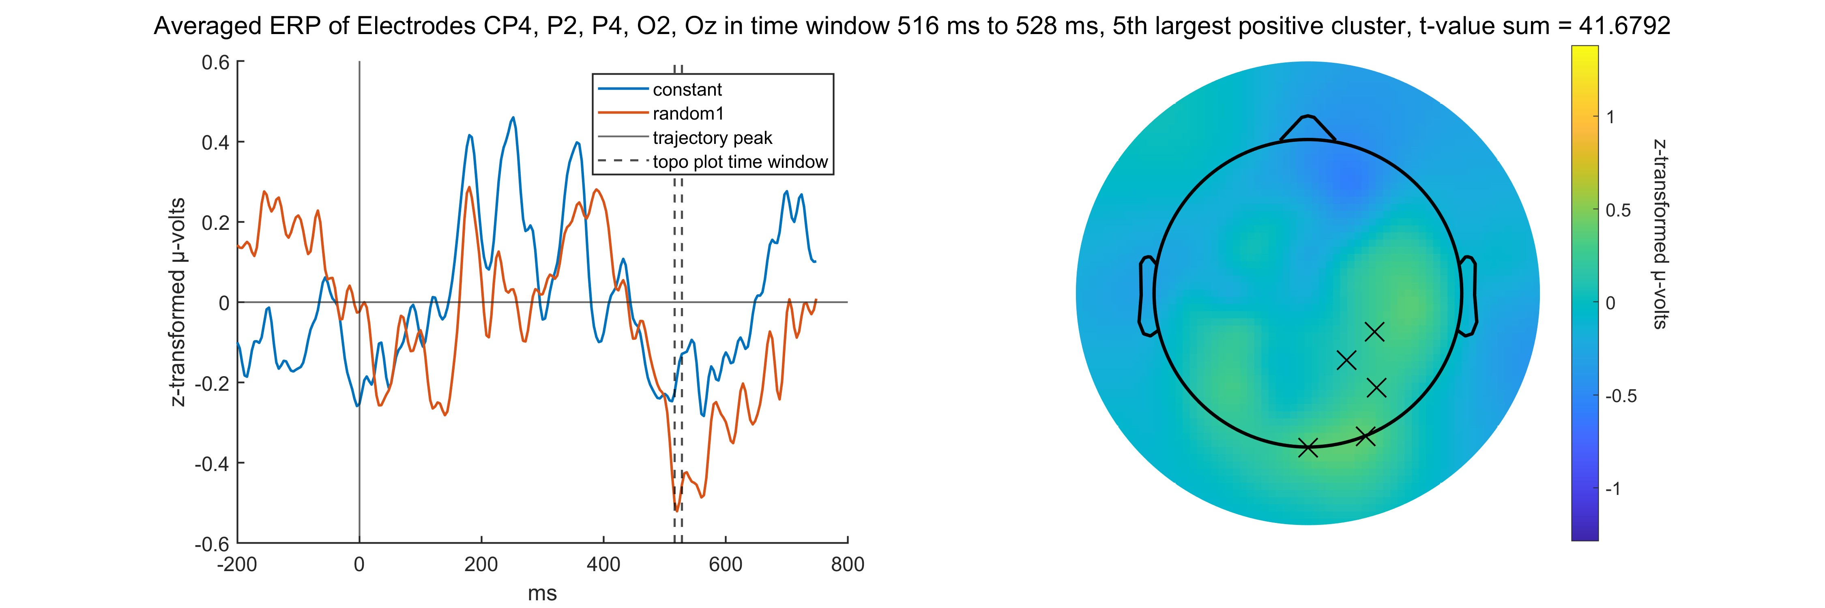
Topoplots Positive

Slide 9
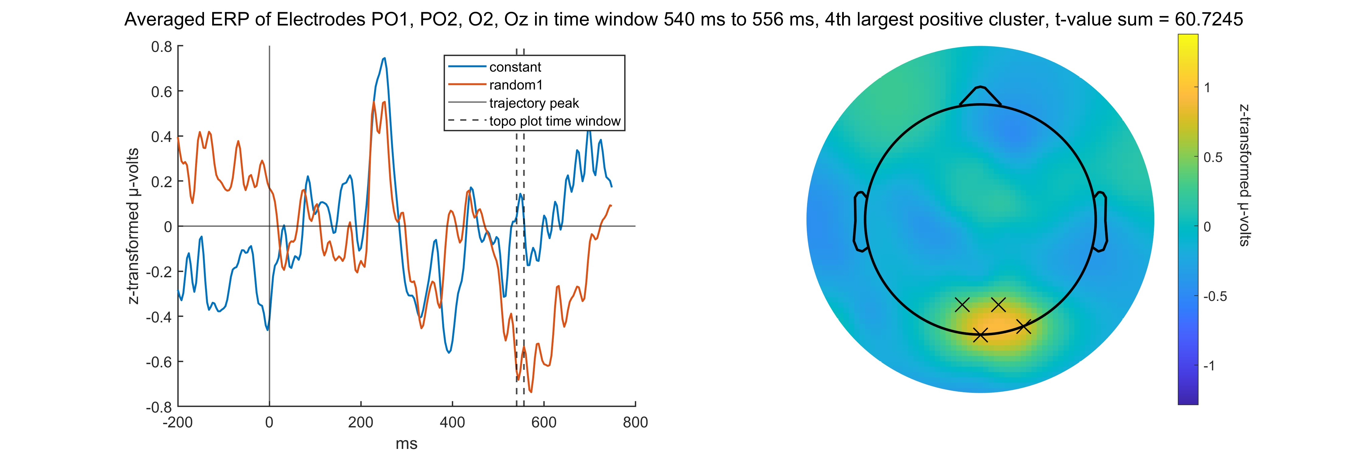
Topoplots Positive

Slide 10
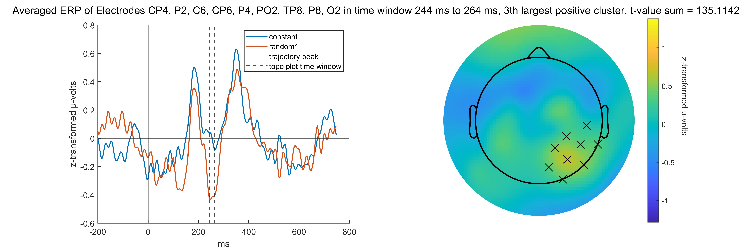
Topoplots Positive

Slide 11
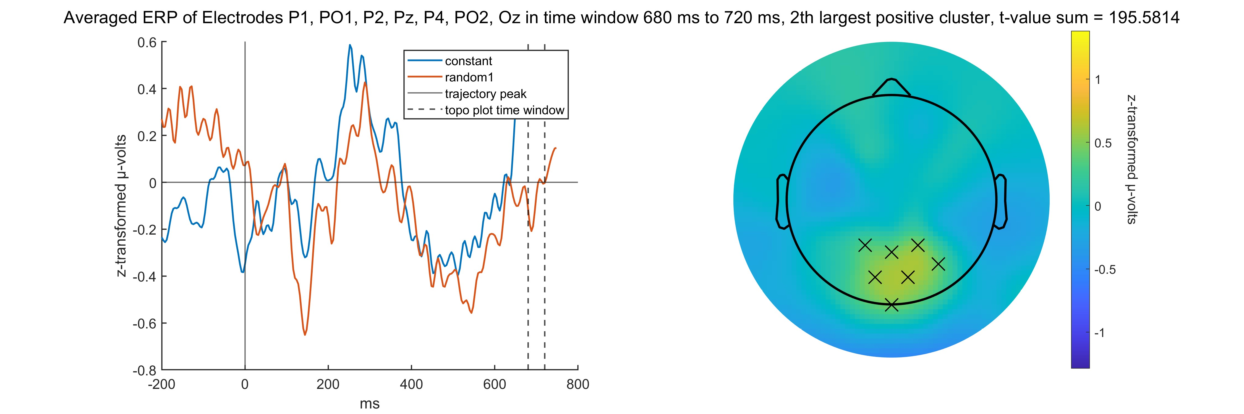
Topoplots Positive

Slide 12
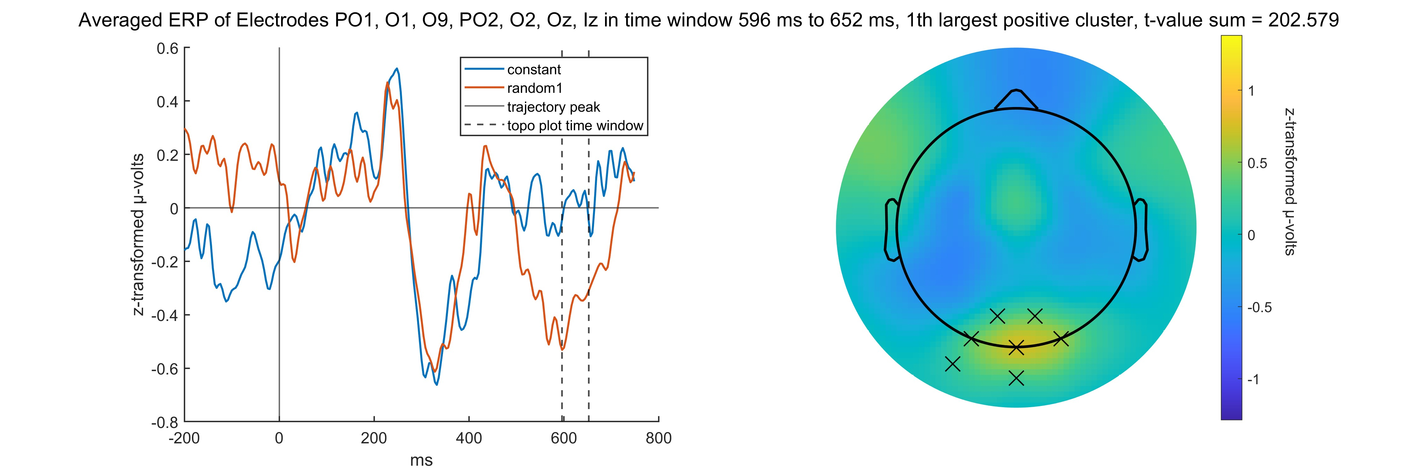
Topoplots Positive

Slide 13
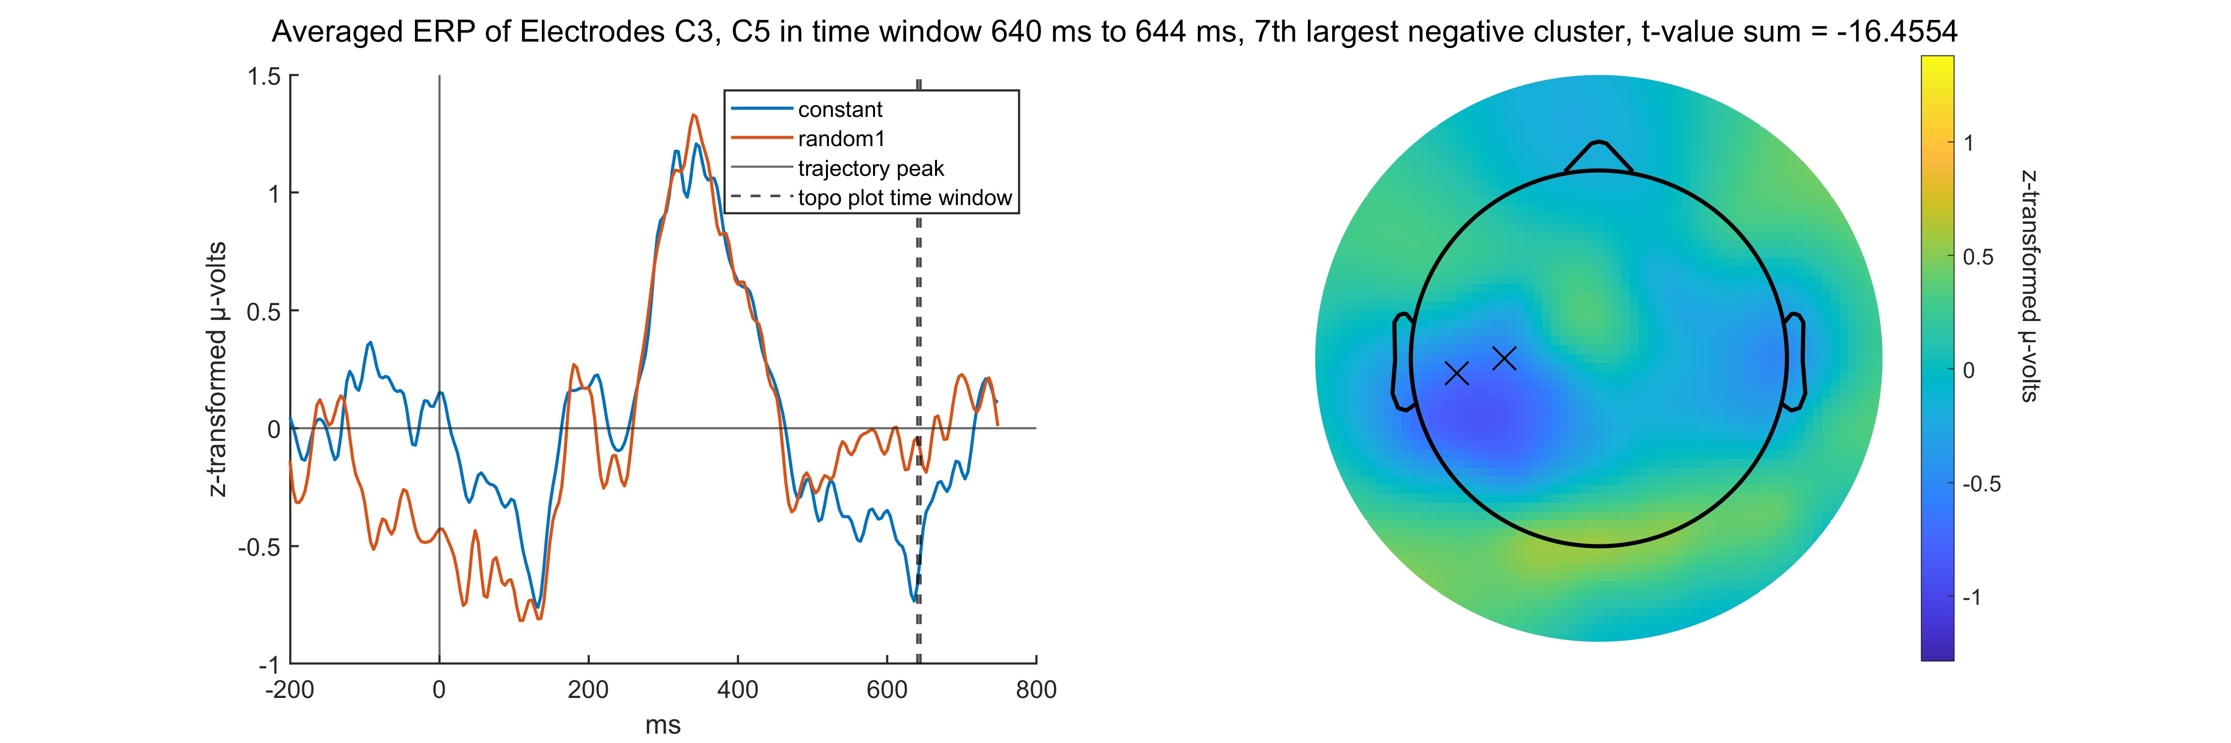
Topoplots Negative

Slide 14
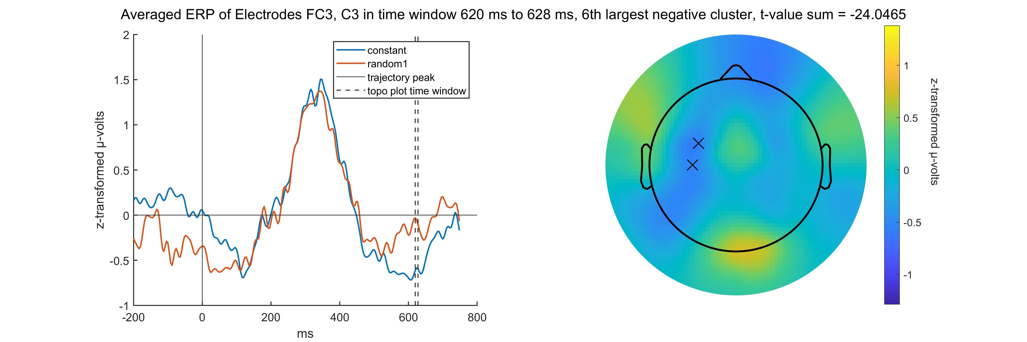
Topoplots Negative

Slide 15
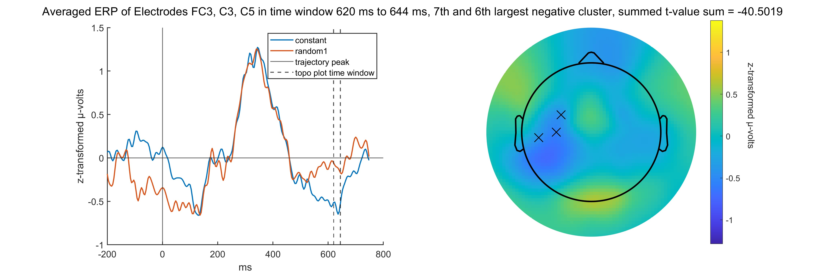
Topoplots Negative – 6 and 7 together

Slide 16
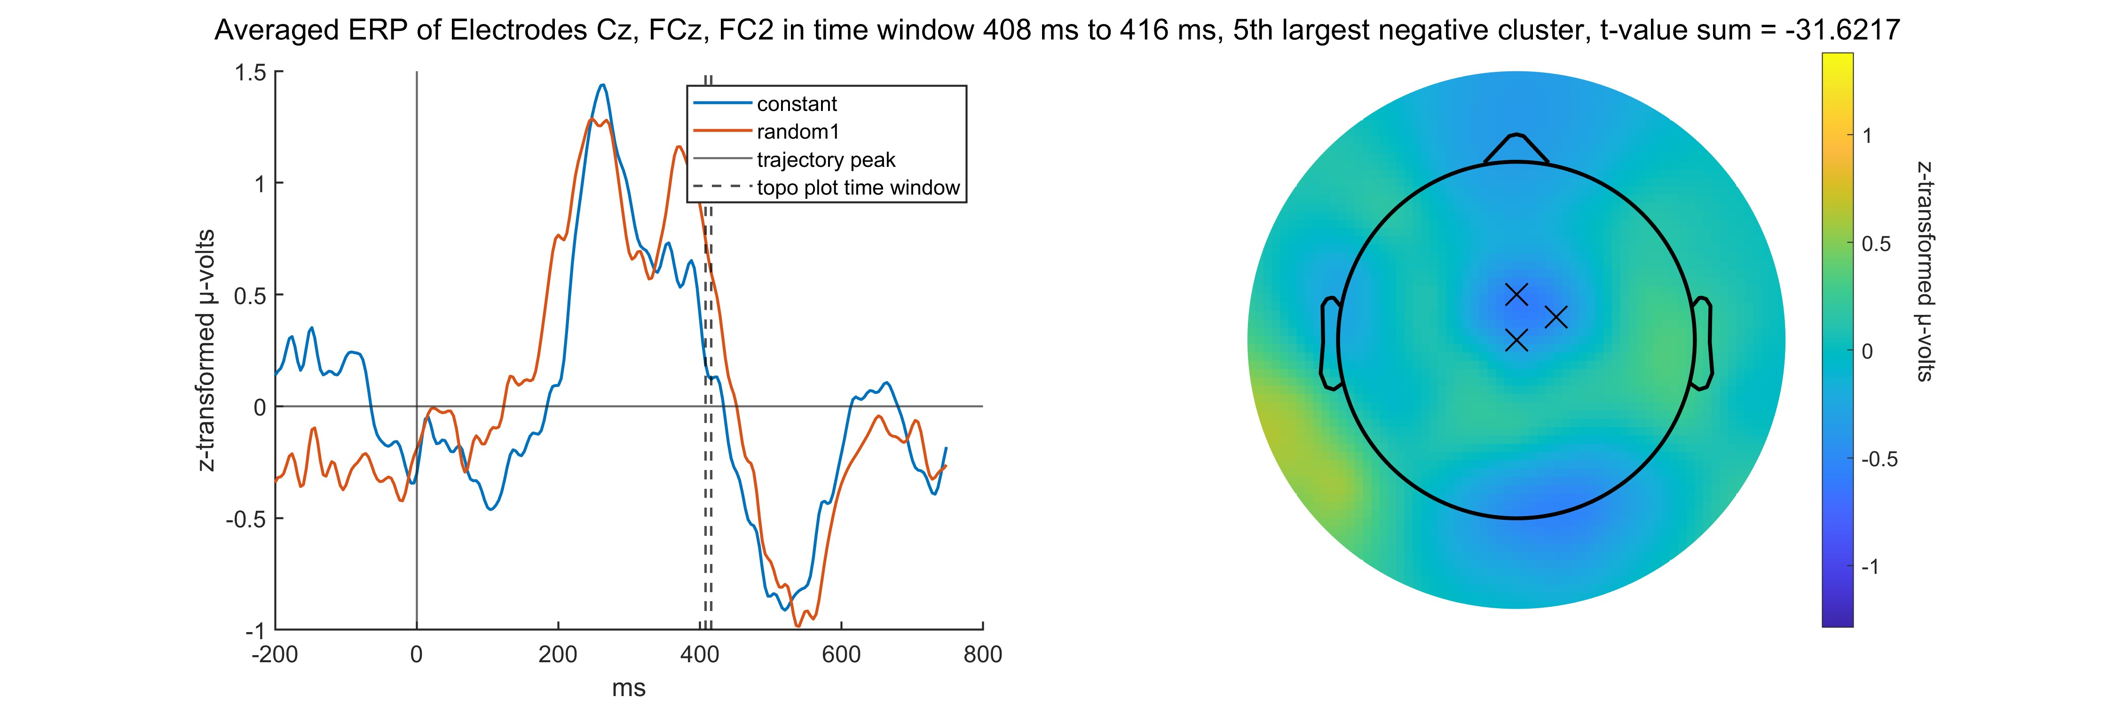
Topoplots Negative

Slide 17

Topoplots Negative

Slide 18
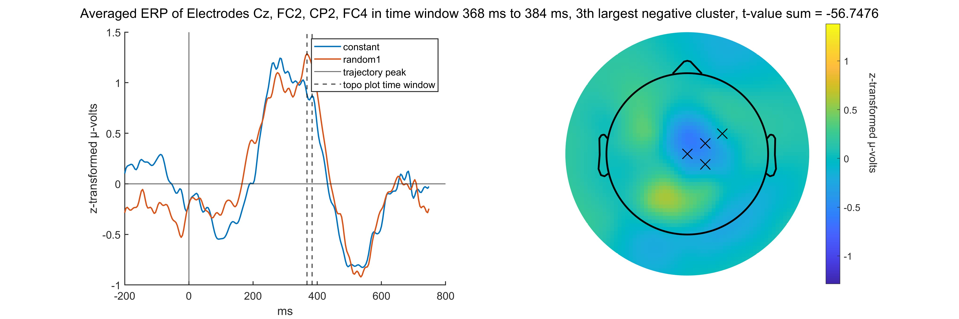
Topoplots Negative

Slide 19
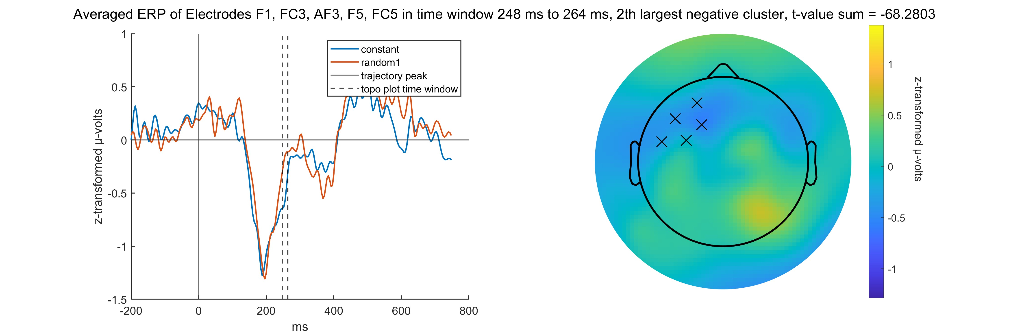
Topoplots Negative

Slide 20
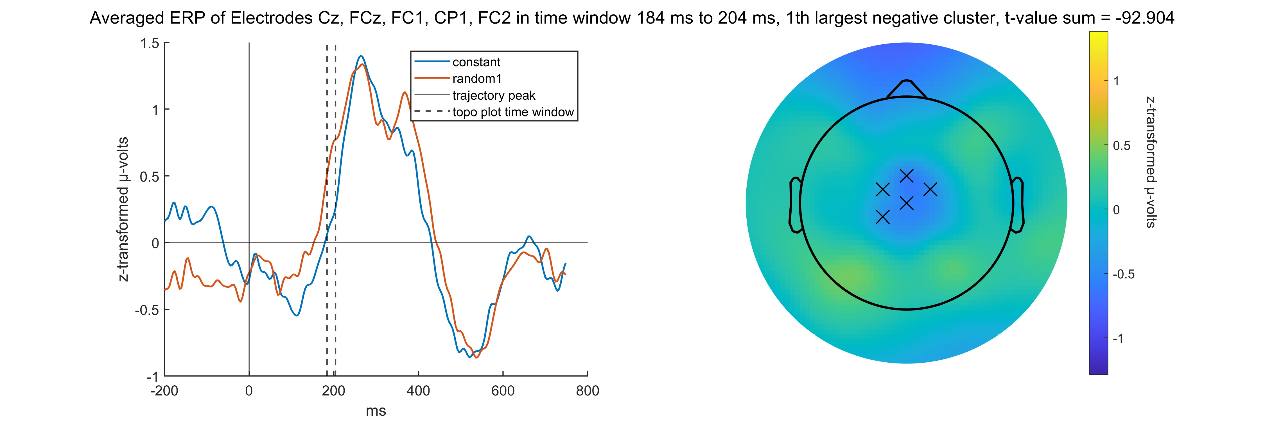
Topoplots Negative

Slide 21
My Conclusion
Time intervals are short compared to occluded – visible.
Most clusters are very long after the trajectory peak
Most clusters in constant – random are smaller or equally small like the ones we chose not to report in occluded - visible
That differences in between clusters with more electrodes tend to look smaller in the ERP plot might be an artifact caused by averaging the electrodes
Same goes for not very contrasted topoplots the longer the time interval, this time cause by averaging over many samples

Slide 22
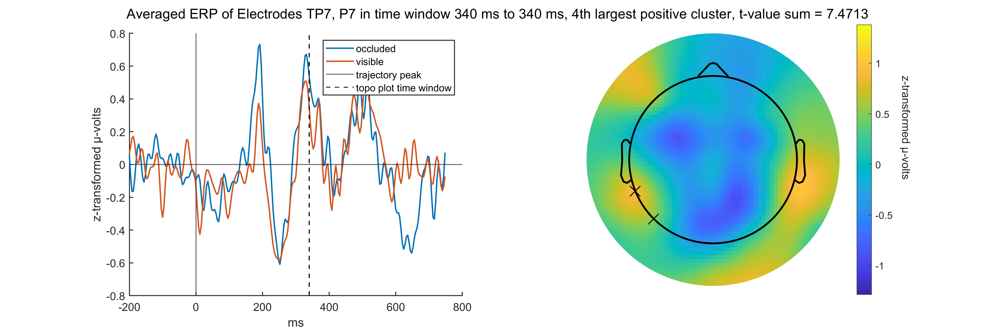
Topoplots Positive

Slide 23
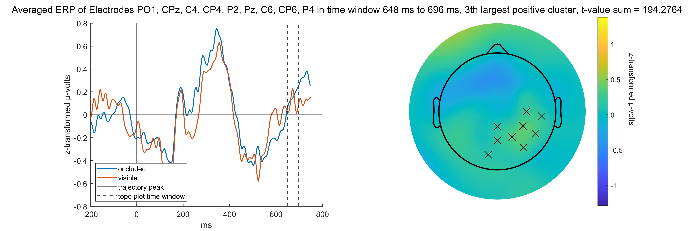
Topoplots Positive

Slide 24
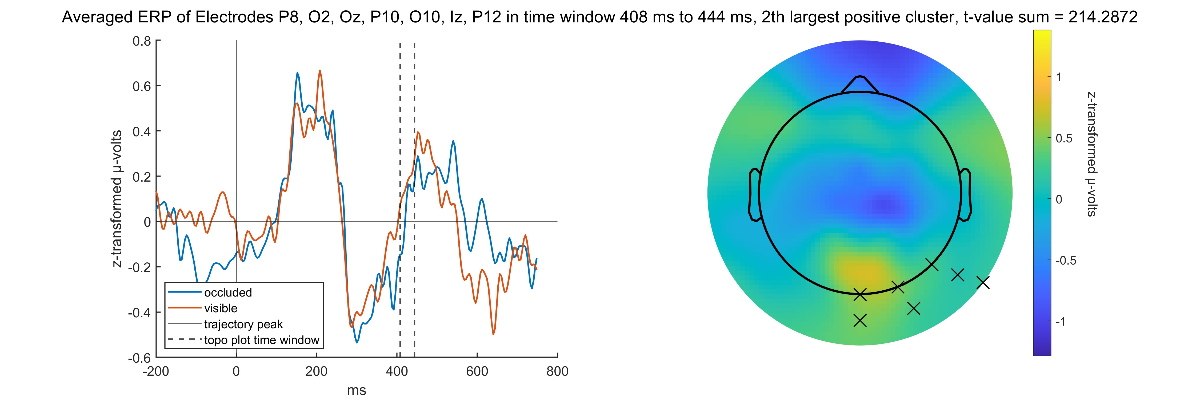
Topoplots Positive

Slide 25
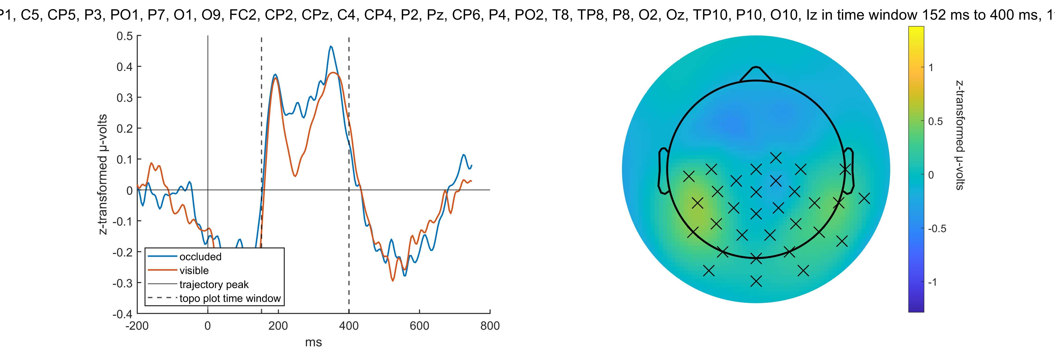
Topoplots Positive

Slide 26
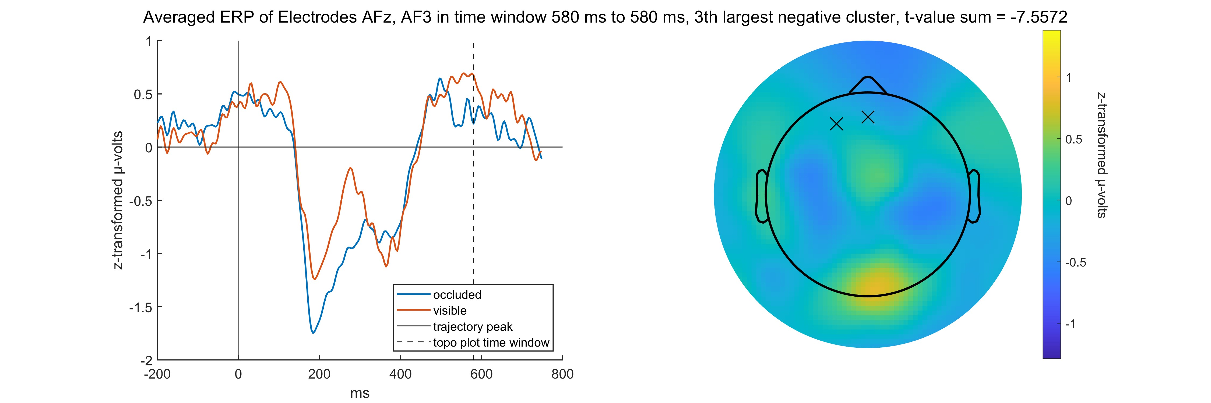
Topoplots Negative

Slide 27
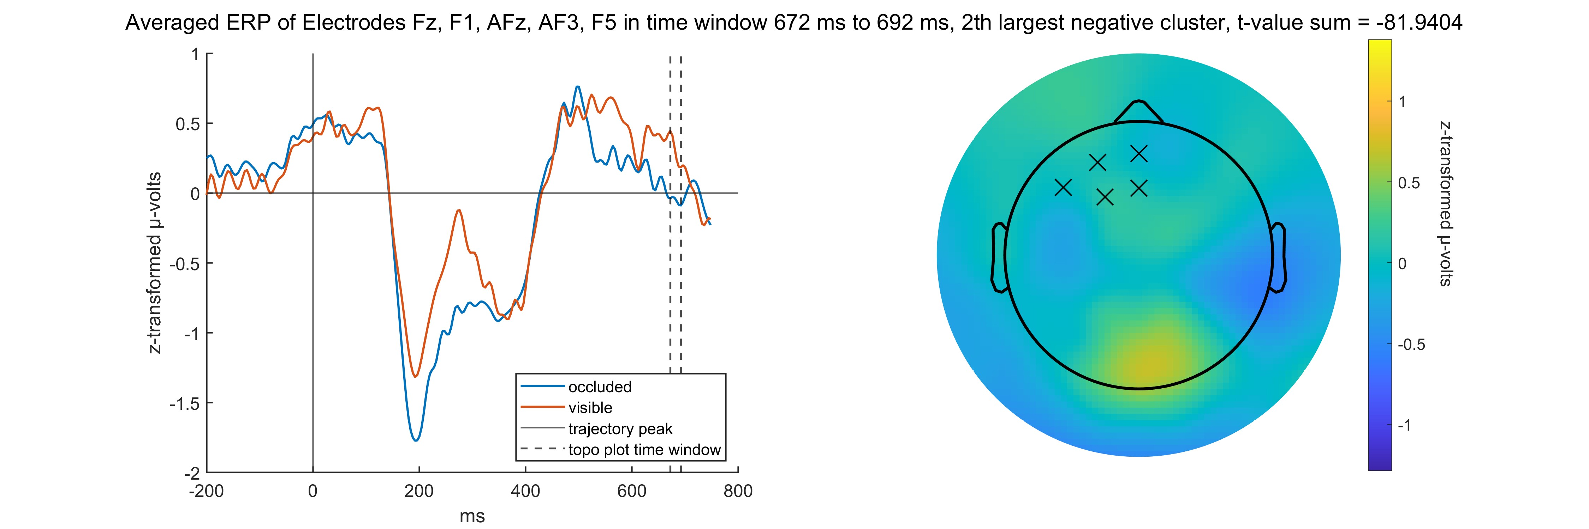
Topoplots Negative

Slide 28
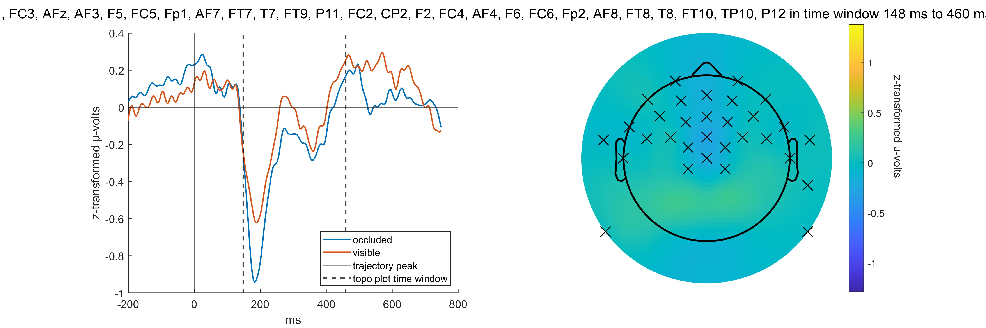
Topoplots Negative

